Slide 1
Occupant Loads
Select the appropriate choice between gross and net area
Calculate the occupant load

Slide 2
Historic Fire
Ghost Ship

Slide 3
Occupant Load Factors
Gross
Net
Mixed use

Slide 4
Occupant Load Factors
Minimum design value
  Are more people acceptable?
Origin of load factors
Meaning of words
  Based on use
Rounding rules

Slide 5
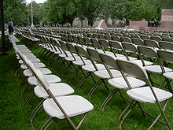

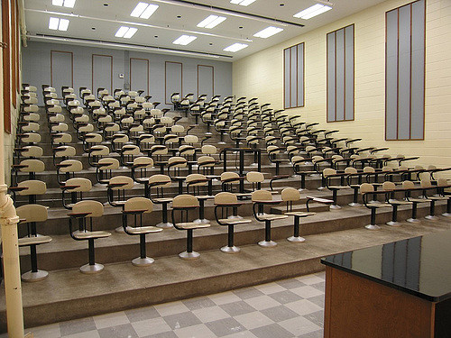
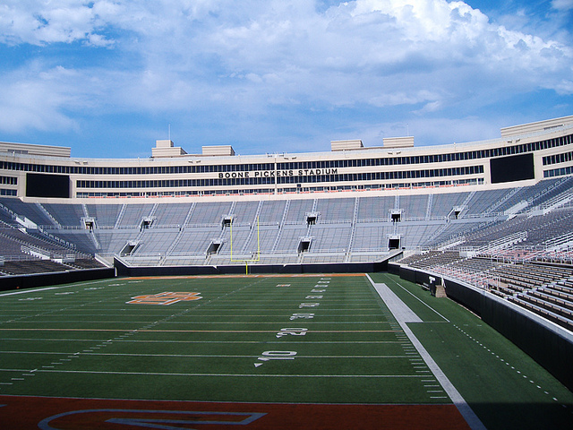
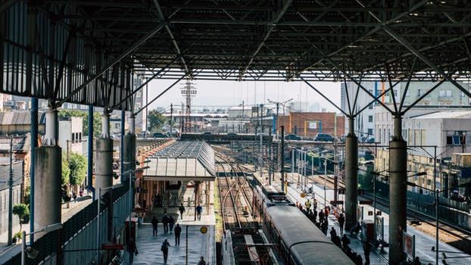
Seating Arrangements
Concentrated
Less concentrated
Fixed
Bench
Waiting spaces

Slide 6
Malls
Load factor varies with size of mall

